Slide 1
Macroeconomics ECON 101
Economic Growth, the Financial System, and Business Cycles
(Chapter 6)
Instructor: Muhebullah Karimzada
Notes:
If this PowerPoint presentation contains mathematical equations, you may need to check that your computer has the following installed:
1) MathType Plugin
2) Math Player (free versions available)
3) NVDA Reader (free versions available)

Slide 2
Chapter Outline
6.1 Long-Run Economic Growth
6.2 Saving, Investment, and the Financial System
6.3 The Business Cycle

Slide 3
Long-Run Economic Growth
6.1 Learning Objective
When we speak of long-run economic growth, we mean the process by which rising productivity increases the average standard of living.
This is in contrast to the short run swings in the economy inherent to the business cycle, the alternating periods of economic expansion and economic recession.
The most commonly used measure of this average standard of living is real GDP per capita: The amount of production in the economy, per person, adjusted for changes in the price level.

Slide 4
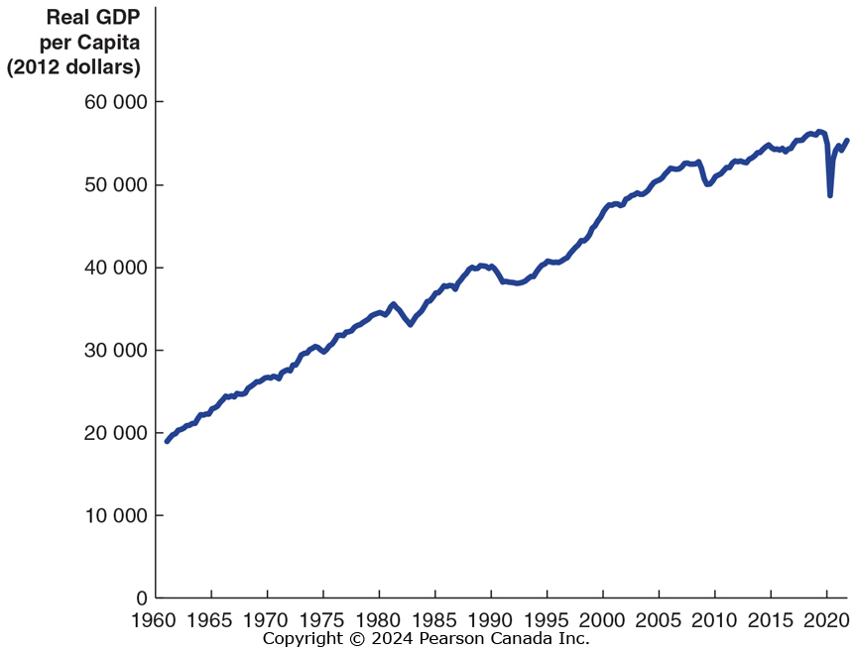
Figure 6.1 Real GDP per Capita, 1961–2021
SOURCES: Statistics Canada, “Population Estimates, Quarterly,” Table 17-10-0009-01; and “Vintages of Releases of Gross Domestic Product, Expenditure Based (×1,000,000),” Table 36-10-0431-01.
Measured in 2012 dollars, real GDP per capita has risen more than 3 fold since 1961; the average Canadian can buy almost three times as many goods and services in 2021 as the average Canadian could in 1961.

Slide 5
Calculating Growth Rates and the Rule of 70
The growth rate of an economic variable like real GDP or real GDP per capita is equal to the percentage change from the previous year.
Year | Real GDP
2020 | $2058 billion
2021 | $2125 billion
Over periods of a few years, we can average the growth rates to find the approximate annual rate of growth:
Year | Growth in real GDP
2019 | 1.7%
2020 | −3.1%
2021 | 3.3%

Slide 6
Growth Rates over Longer Periods
For longer time periods, we do not calculate each of the annual growth rates and then take an average in order to find the average annual growth rate; instead we solve for the growth rate g, where:
Previous real GDP × (1+g)^{t} = Current real GDP
with “t” the number of time periods between the previous and current periods.
A useful shortcut called the Rule of 70 can help us to determine how long it will take for an economic variable to double:
So if the growth rate is 5%, it will take about 14 years for the variable to double.

Slide 7
What Determines the Rate of Long-Run Growth?
Increases in real GDP per capita rely on increases in labour productivity: the quantity of goods and services that can be produced by one worker or by one hour of work.
Why can the average Canadian consume three times as many goods and services now, than as in 1961?
Because the average Canadian produces three times as many goods and services in an hour now, than as in 1961.
So if increase in labour productivity are the key to long-run economic growth, what causes labour productivity to grow?

Slide 8
Factors Affecting Labour Productivity Growth
Increases in capital per hour worked
Capital is a durable manufactured good that is used to produce other goods and services.
The more capital a worker has available to use (including human capital, the accumulated knowledge and skills workers possess), the more productive he or she will be.
Technological change
Improvements in methods to combine inputs into outputs (i.e. new technologies) allow workers to produce more in a given period of time.
The role of entrepreneurs here is critical, in pioneering new ways to bring together the factors of production to produce better or lower-cost products.

Slide 9
Potential GDP
Potential GDP refers to the level of real GDP attained when all firms are operating at capacity. Capacity here refers to “normal” hours and a “normal” sized workforce.
Potential GDP rises when the labour force grows, new factories are built, new equipment and machinery are installed and technological change takes place.

Slide 10
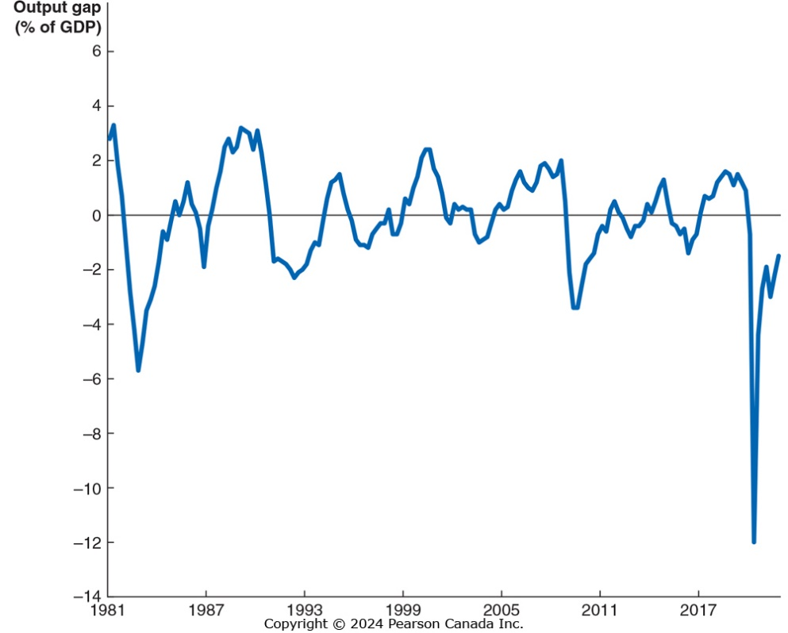
Figure 6.2 The Output Gap
SOURCE: Data from Bank of Canada, https://www.bankofcanada.ca/?p=39818.
The Bank of Canada measures the “output gap” as the difference between actual GDP and potential GDP.
When the output gap is positive, actual GDP is above potential – the economy is using resources in an unsustainable way.
When the output gap is negative, actual GDP is less than potential, and resources are underutilized.

Slide 11
An Overview of the Financial System
Financial markets are markets where financial securities, such as stocks and bonds, are bought and sold.
A financial security is a document (sometimes electronic) stating the terms under which funds pass from the buyer of the security to the seller.
A stock is a financial security representing partial ownership of a firm.
A bond is a financial security promising to repay a fixed amount of funds. A bond is essentially a loan from a household to a firm.
Financial intermediaries are firms, such as banks, mutual funds, pension funds, and insurance companies, that borrow funds from savers and lend them to borrowers.
Some financial intermediaries, like mutual funds, sell shares to savers then use the funds to buy financial securities.

Slide 12
Three Key Services of the Financial System
The financial system provides three key services:
Risk-sharing
By allowing investors to spread their money over many different assets, investors can reduce their risk while maintaining a high expected return on their investment
Liquidity
The financial system allows savers to quickly convert their investments into cash.
Information
The prices of financial securities represent the beliefs of other investors and financial intermediaries about the future revenue stream from holding those securities. Financial system gathers and communicate this information.

Slide 13
The Macroeconomics of Saving and Investment
We will now derive the result that the total value of saving in the economy must equal the total value of investment.
Recall that we can express the GDP of a nation (Y) as the sum of consumption (C), investment (I), government purchases (G), and net exports (NX). That is,
Y = C + I + G + NX
For the sake of simplicity, we will assume a closed economy, with no exports or imports; so
Y = C + I + G
We can rearrange this to obtain an expression for investment:
I = Y − C − G
That is, investment in a closed economy is equal to income minus consumption and government purchases.

Slide 14
Total Saving
Saving is composed of private saving (by households, S_{Private}) and public saving (by the government, S_{Public}).
S_{Private} is all household income that is not spent. Household incomes are the payments for factors of production (Y) and transfer payments (TR); households spend money on consumption (C) and taxes (T). So
S_{Private} = Y + TR − C − T
Government “saves” whatever it receives in taxes but does not spend (this may be negative):
S_{Public} = T − G − TR
So total saving is:
S = S_{Private} + S_{Public} =(Y + TR − C − T) + (T − G − TR)
= Y − C − G

Slide 15
Saving Equals Investment
The two previous slides led us to the same expressions for savings and investment. So we conclude that savings must equal investment:
S = I
When S_{Public} is zero, the government spends as much as it receives in taxes; this is known as a balanced budget.
Negative and positive values for S_{Public} are known as budget deficits and budget surpluses respectively.
Since the federal government funds its current deficits with borrowing (selling bonds), this takes away from the money available for investment spending.

Slide 16
The Market for Loanable Funds
If saving must equal investment, how exactly does this occur?
The financial system is composed of many different markets—the market for stocks, for bonds, for certificates of deposits at banks, etc.
A convenient way to think of all these different markets as making up the market for loanable funds, where an (conceptual) interaction of borrowers and lenders determine the market interest rate and the quantity of loanable funds exchanged.
For now, we will assume that interactions are only between domestic households and firms—there is no interaction from foreign lenders and borrowers.

Slide 17
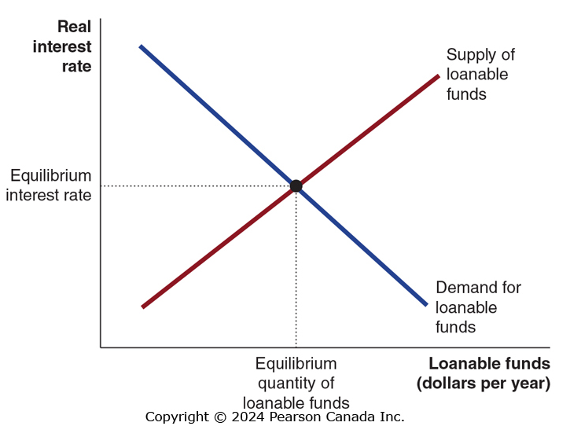
Figure 6.3 The Market for Loanable Funds
Firms borrow loanable funds from households. The lower the real interest rate the more they borrow.
Households supply loanable funds to firms. The greater the reward for delaying consumption—a higher real interest rate – the more they save.
Governments, through their saving or dissaving, affect the quantity of funds that “pass through” to firms.

Slide 18
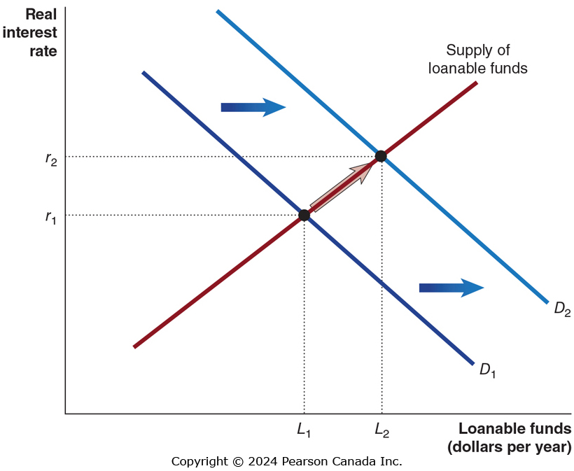
Figure 6.4 An Increase in the Demand for Loanable Funds
Suppose that technological change occurs so that investments become more profitable for firms.
This will increase the demand for loanable funds.
The real interest rate will rise, as will the quantity of funds loaned.

Slide 19
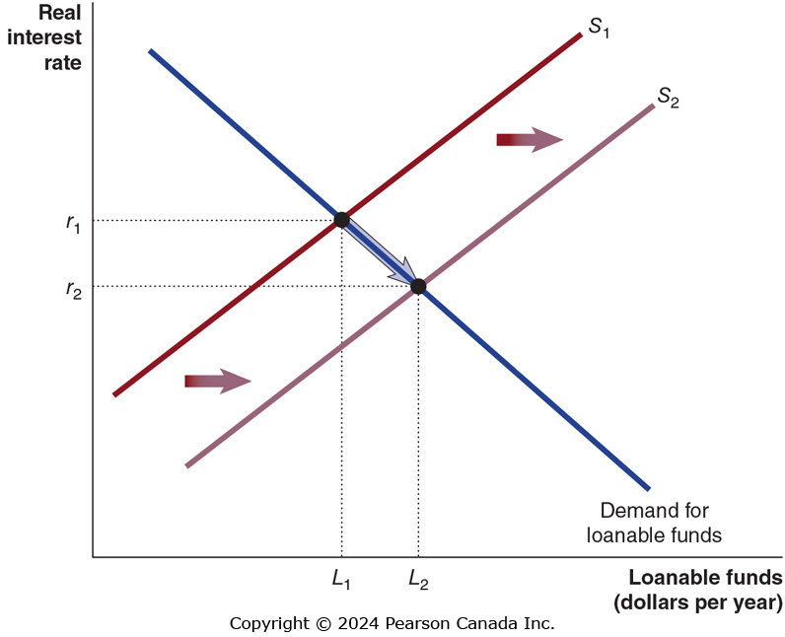
Figure 6.5 An Increase in the Supply of Loanable Funds
Suppose household change their beliefs about saving and start saving more at any interest rate.
The supply of loanable funds will shift to the right.
The real interest rate will fall, and the quantity of funds loaned will increase.

Slide 20
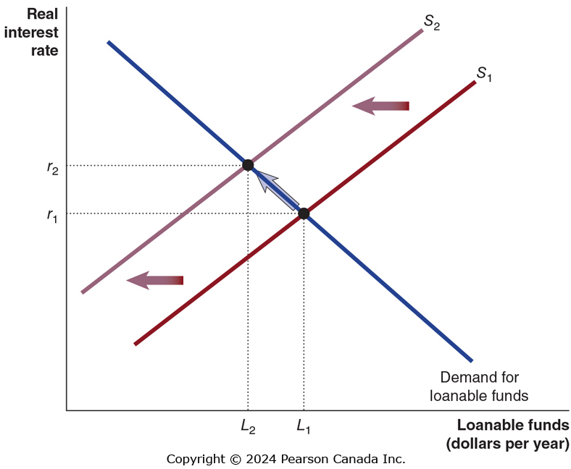
Figure 6.6 The Effect of a Budget Deficit on the Market for Loanable Funds
Suppose the government runs a budget deficit.
To fund the deficit, it borrows from households, decreasing the supply of funds available to firms.
This raises the equilibrium real interest rate, and decreases the funds loaned to firms.
This is referred to as crowding out: the decline in private expenditures as a result of an increase in government purchases.

Slide 21
How Important is Crowding Out?
In practice, the effect of government budget deficits and surpluses on the equilibrium interest rate is relatively small.
Why would the effect be so small?
Interest rates are influenced by global saving, so even a several billion dollars is a relatively minor amount.
Small, however, does not mean non-existent.
Paying off government debt in future may require higher taxes, which can depress economic growth.

Slide 22
The Business Cycle
6.3 Learning Objective
Explain what happens during the business cycle.
While real GDP per capita has risen about three-fold since 1961, it has not risen consistently every year.

Slide 23
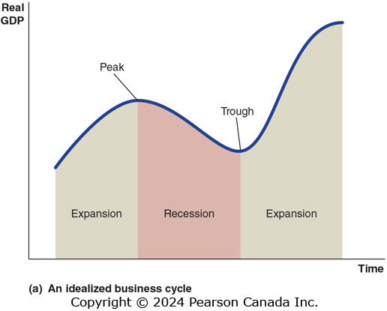
Figure 6.7 The Business Cycle (1 of 2)
The figure shows a typical idealized path for real GDP—rising, falling, then rising again.
The phases of rising are known as expansions; the periods of falling are recessions.
We refer to the points at which the economy changes from one phase to the other as peaks or troughs, respectively.
SOURCE: Statistics Canada, “Gross Domestic Product, Expenditure Based, Canada, Quarterly (×1,000,000),” Table 36-10-0104-01.

Slide 24
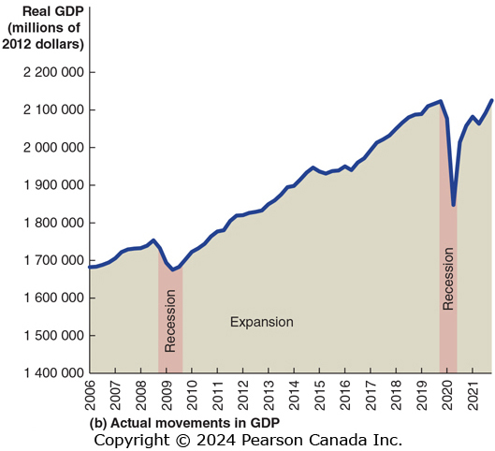
Figure 6.7 The Business Cycle (2 of 2)
This figure shows the movements in Canadian real GDP from 2006 to 2021.
After the peak of the business cycle in 2008, the economy entered recession from 2008 to 2009, when the trough of the business cycle was reached and expansion started again.
After the next peak occurred in 2019, the recession started during the first portion of 2020 due to a blow from the COVID-19 pandemic was particularly deep, with the trough being in between April and June 2020.
The economy began to recover toward the end of 2020 and had only reached the same level as in 2019 at the end of 2021.
SOURCE: Statistics Canada, “Gross Domestic Product, Expenditure Based, Canada, Quarterly (×1,000,000),” Table 36-10-0104-01.

Slide 25
How Do We Know The Economy Is in a Recession?
Statistics Canada produces many statistics that make it possible to monitor the economy.
There is no agency in Canada that defines when a recession begins or ends.
There is a general agreement that a recession is defined as two consecutive quarters of negative real GDP growth. That is six months of falling real GDP.

Slide 26
The Effect of the Business Cycle on the Inflation Rate
The inflation rate is the percentage increase in the price level from one year to the next.
During expansions, demand for products is high relative to supply, resulting in prices increasing—high inflation.
During recessions, demand for products is low relative to supply, resulting in prices increasing more slowly or even decreasing—low inflation or deflation.
Figure 6.8 on the next slide shows the movements in the (CPI) inflation rate over the last three recessions Canada has experienced.

Slide 27
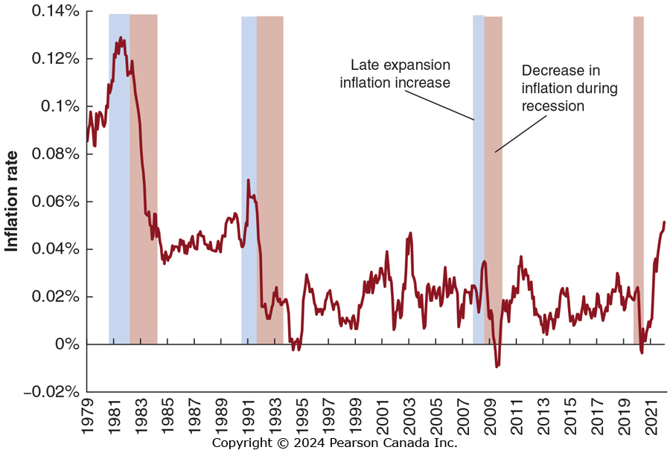
Figure 6.8 The Effect of Recessions on the Inflation Rate
Notice that inflation tends to rise during an expansion and fall over the course of each recession.
SOURCE: Statistics Canada, “Consumer Price Index, Monthly, Not Seasonally Adjusted,” Table 18-10-0004-01.

Slide 28
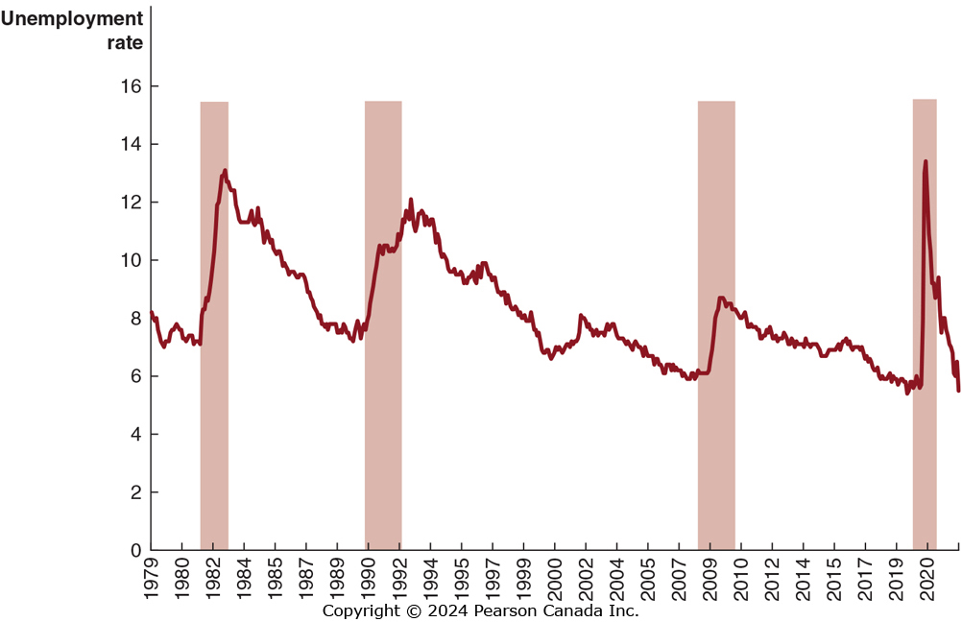
Figure 6.9 How Recessions Affect the Unemployment Rate
As firms see their sales start to fall in a recession, they generally reduce production and lay off workers.
Notice that unemployment often continues to rise during each recession.
SOURCE: Statistics Canada, “Labour Force Characteristics, Monthly, Seasonally Adjusted and Trend-Cycle, Last 5 Months,” Table 14-10-0287-01.

